Slide 1
Unity UI Optimization
https://unity3d.com/learn/tutorials/temas/best-practices/guide-optimizing-unity-ui
https://divillysausages.com/2016/01/21/performance-tips-for-unity-2d-mobile/
https://bitbucket.org/Unity-Technologies/ui/

Slide 2
Common Problems (常见问题)
Excessive GPU fragment shader utilization (i.e. fill-rate overutilization)
fillrate = screen pixels * shader complexity * overdraw
Excessive CPU time spent rebuilding a Canvas batch
Excessive numbers of rebuilds of Canvas batches (over-dirtying)
Excessive CPU time spent generating vertices (usually from text)

Slide 3
Batching机制
Within the Canvas(同一个画布)
Walk hierarchy from top to bottom (从上到下)
Same material, same texture and do not have intermediate layers
(相同材质，相同纹理，没有中间层隔断)

Slide 4
Trade-Offs (权衡)
Unity UI 在透明层级渲染，每一个像素都会被取样处理 (fill-rate)
不同UI界面需要具体情况具体分析 (Profile)
Draw calls VS Batching Cost
Draw calls VS Easy UI Design

Slide 5
分析工具
Unity Frame Debugger (分析draw call)
Unity Profiler (分析性能热点)
Canvas.UpdateBatch/BuildBatch -> 过多的Canvas Renderer组件，拆分
Canvas.Render -> fill-rate受限
Canvas.SendWillRenderCanvases -> Graphics Rebuild时间过长
https://unity3d.com/learn/tutorials/temas/best-practices/unity-ui-profiling-tools

Slide 6
Possible fixes
De-active Invisible UI (e.g. Opaque background)
Disable root GameObjects or Canvas Renderer (no rebatch)
Disable 3D camera output (not applicable in our case)
Or Cache visible portion of 3D world into a render texture
Split Canvas to reduce re-batch cost
Merge to reduce draw call
1. static elements into the background
2. drawbacks: more artist work, low reuse, memory increase

Slide 7
Continued…
Minimum UI shader (no clipping, masking), unlit texture shader for solid sprites
Child order matters (sprites and text overlap)
Raycaster and Raycaster Target (at root)
Avoid Dynamic Fonts
Combine sprites of the same UIPanel into one Atlas (for batching)

Slide 8
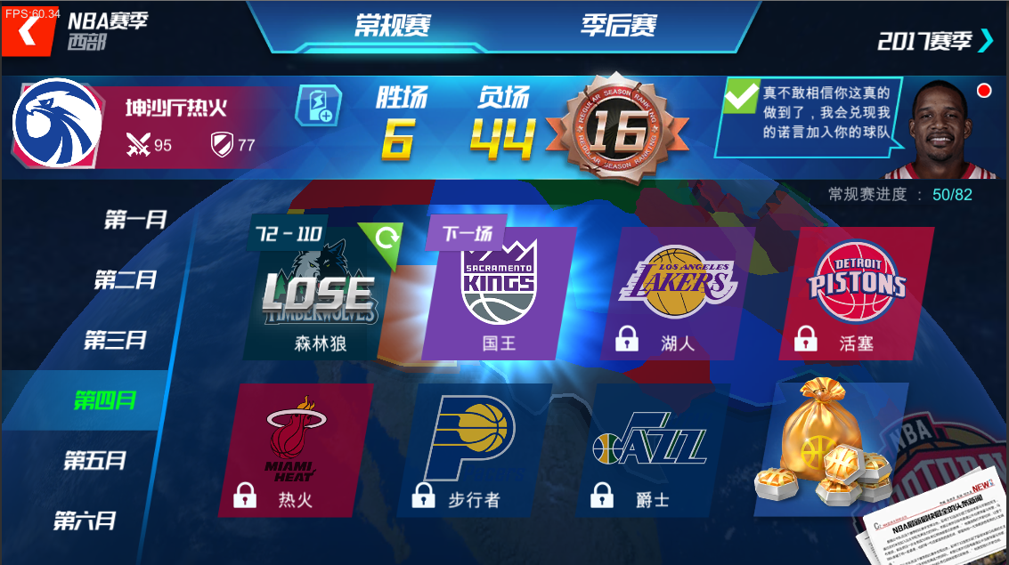
NBA赛季界面

Slide 9
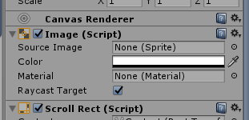
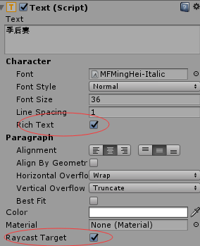


已做的优化
去除无用的Canvas Renderer
去除无用的Raycast Target (both image and text)
Text组件关掉Rich Text(if no emoji)和Best Fit
优化“下一场”比赛的背景光的shader
UI ‘Fast’ shader

Slide 10
可做的优化
LensMask和蓝色背景融合到一层
Skybox和地球渲到RenderTexture上
TextMesh或者TextMesh Pro代替Text组件
更有效率的ScrollView插件，或优化Unity ScrollView的使用 (Object Pool)

